Slide 1

Hirearchical based portfolio optimization
12110633 Vincent William Hadiasali
2111925 Nadia Donita
12111313 Zhou Rongqin

Slide 2
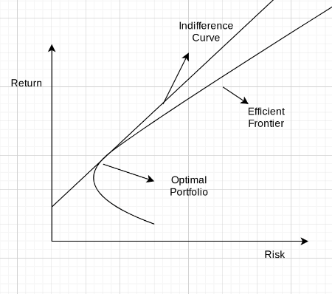
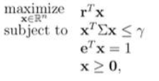
About markowitz
Optimization problem:

Slide 3

需知
Methodology
All time comparison
Backtesting

Slide 4


Data sources
Daily stock price
Risk free rate

Slide 5
Methodology
Determine the return frequency.
Correlation observation.
Extract the best hirearchial quality.
Decide the optimal number of clusters k.
Perform hirearchical clustering and weight assignment.
Assess the financial investment performance metrics
Backtest.

Slide 6
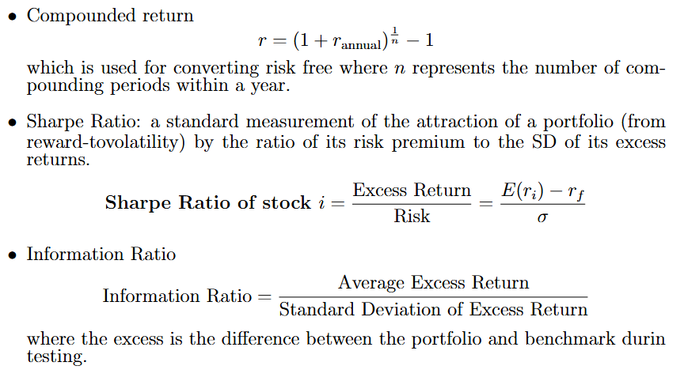
Mathematical equation you may want to know first

Slide 7
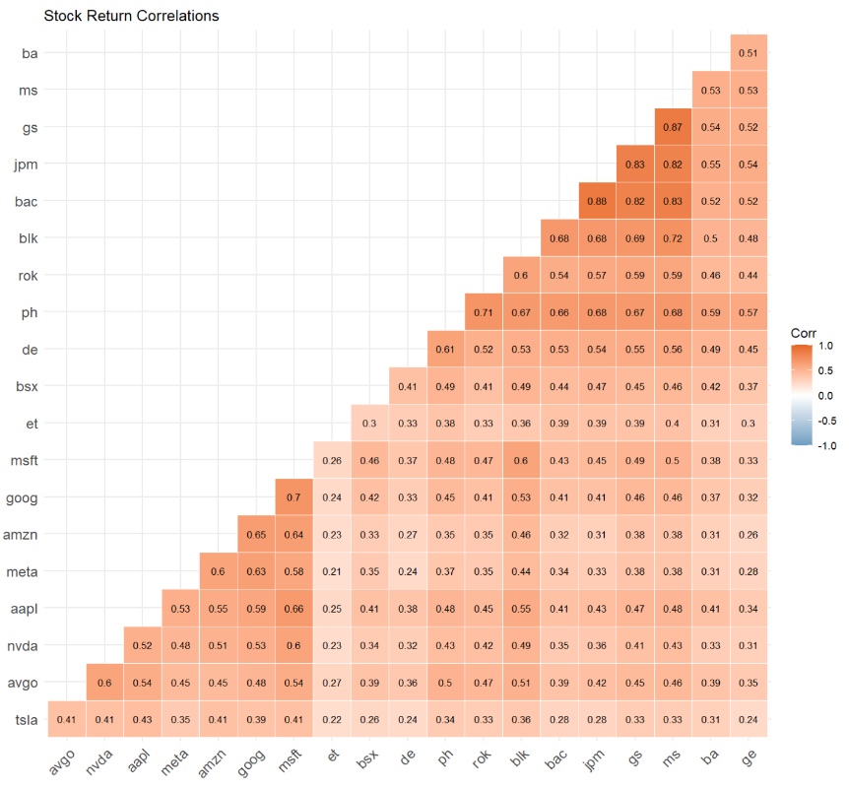
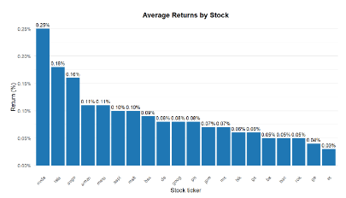
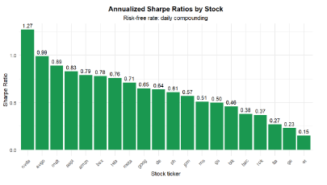
Exploratory Data Analysis

Slide 8
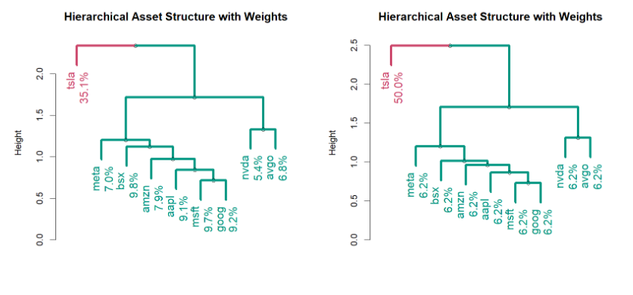
Hirearchial clustering result

Slide 9
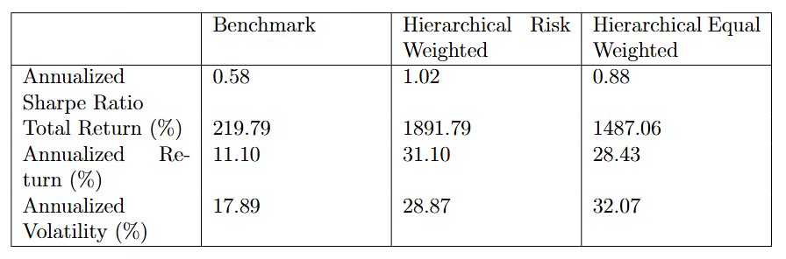
All time Investment return comparison

Slide 10
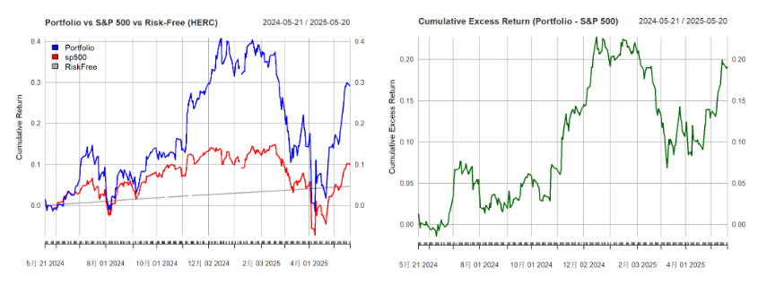
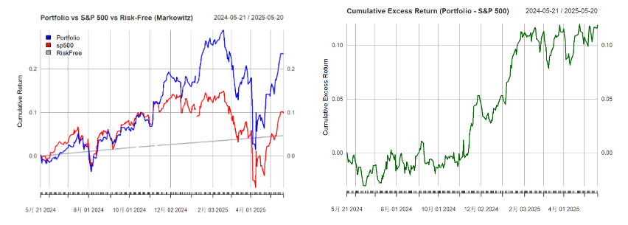
Backtesting result

Slide 11
References
Raffinot, T. (2018). The Hierarchical Equal Risk Contribution Portfolio.SSRN. https://ssrn.com/abstract=32375402.
Bodie, Z., Kane, A., & Marcus, A. J. (2024). Investments (13th ed.). McGraw-Hill.

Slide 12

Thanks for watching.

